Slide 1

Violence Against Native
Women in New Mexico
Rebecca Álvarez, PhD
Author of Vigilante Gender Violence

Slide 2
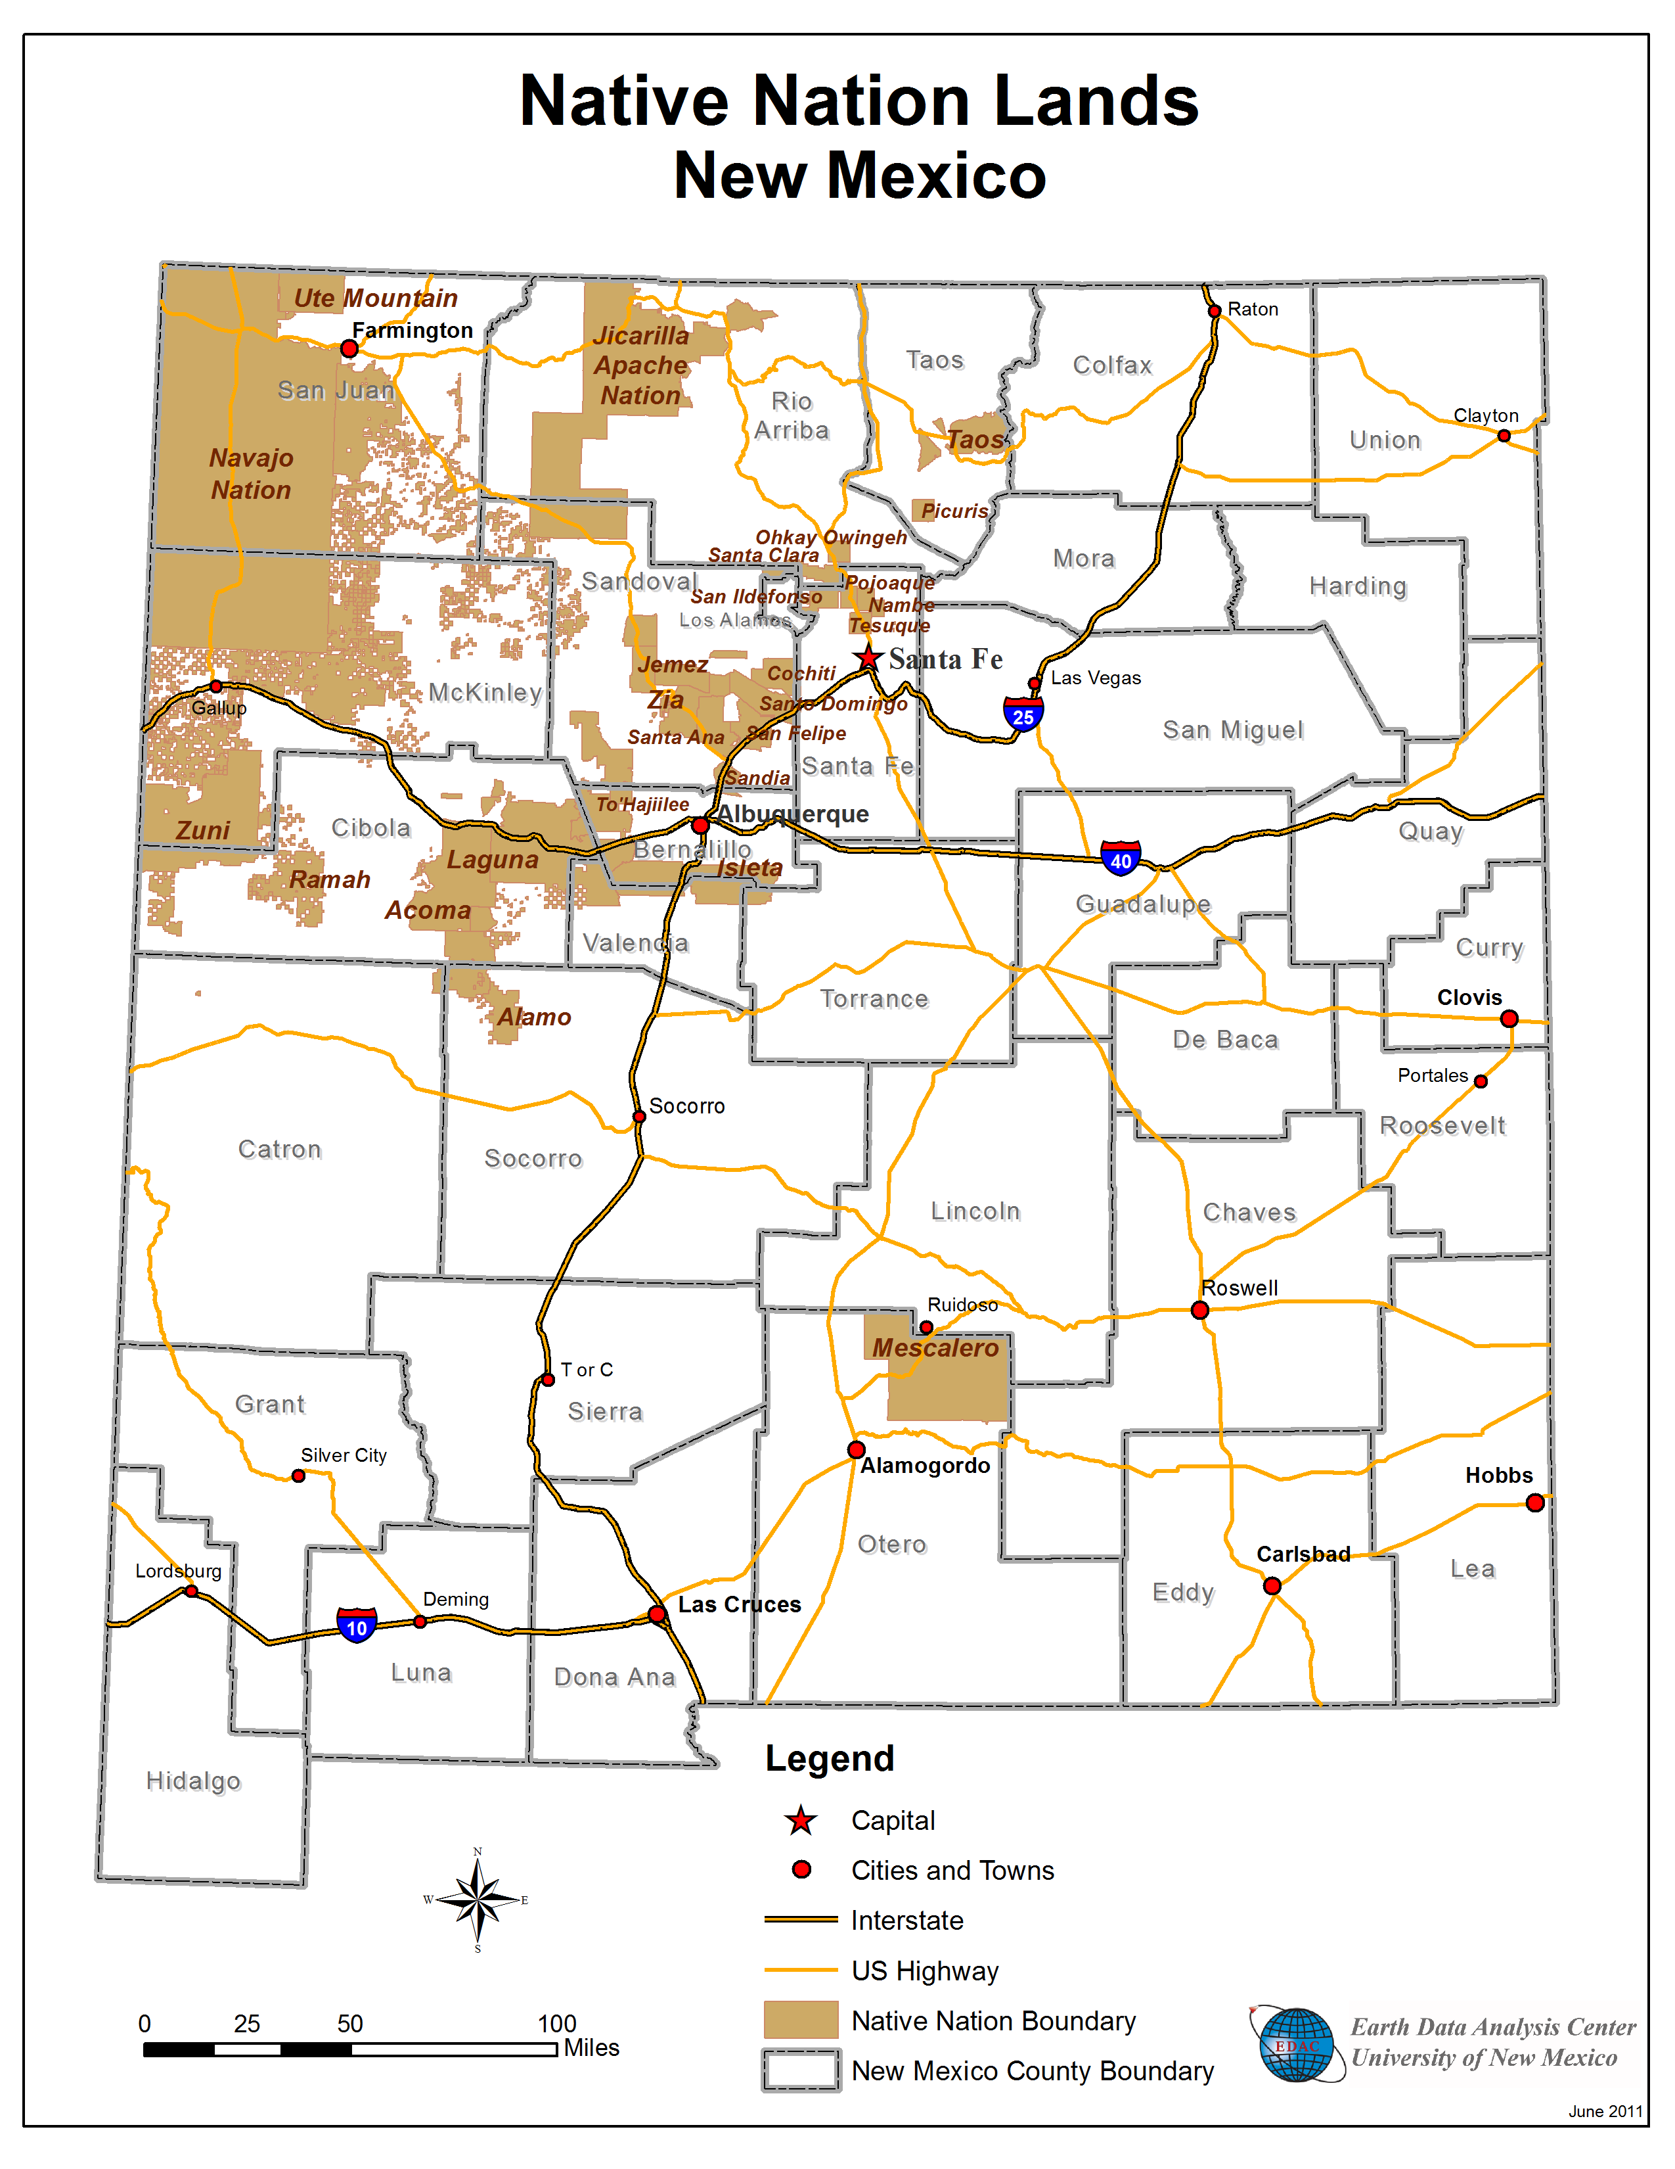
New Mexico Pueblos, Nations, Tribes
      Pueblos
Acoma San Felipe
Cochiti San Ildefonso
Isleta Santa Ana
Jemez Santa Clara
Laguna Kewa
Nambe Taos
Ohkay Owingeh Tesuque
Picuris Zuni
Pojoaque Zia
Sandia
Navajo Nation
Jicarilla Apache Nation
Mescalero Apache Tribe
Fort Sill Apache Tribe
Source: Casey Duma for the APCG-CRC, 9/10/2021

Slide 3
Missing and Murdered
Indigenous Women (and Men)
The Center for Disease Control and Prevention (CDC) has reported that murder is the third-leading cause of death among Native women nationwide and that rates of violence on tribal land can be up to ten times higher than the national average
Most of the focus is on women, as they are more likely to be exploited, but men and boys also are missing and murdered on tribal land at much higher rates
Native American women in New Mexico have the highest rate of homicide among all racial and ethnic groups

Slide 6
Settler Colonialism and Violence Against Indigenous Women
There are many reasons why Indigenous women are more likely to be victims of violence, but it is perhaps best to view the issue through the lens of settler colonialism; when viewed this way, it is apparent that this is a problem that began with colonialism and really never ended
In many parts of what is today the United States, such as Florida and California, there was a deliberate campaign of genocide by settler colonists against Native tribes—which of course, included women
Colonial constructions of power meant that Native women were seen by many colonists as there to be exploited—much like the land itself

Slide 7
Increased Rates of Domestic Violence Stemming from
Intergenerational Trauma
Less discussed, but no less important, are high rates of domestic violence against Native women
Demographic of the perpetrators varies; by some estimates of the Urban Indian Health Institute, non-Native perpetrators make up over 90% of all domestic violence perpetrators against Native women in some states
However, that is not the case in New Mexico
The Coalition to Stop Violence Against Native Women has been formed to address the issue (headquartered in Albuquerque)
By and for Native women
Most domestic violence against Native women goes unreported

Slide 8
What Are the Solutions?
Better data collection
Allocation of more policing resources, especially on tribal land
Better funding of services for victims of domestic and sexual abuse
Jurisdictional sovereignty/ability to prosecute non-Native abusers of women are critical to solving the disparities in domestic violence policing in sovereign tribal land

Slide 9
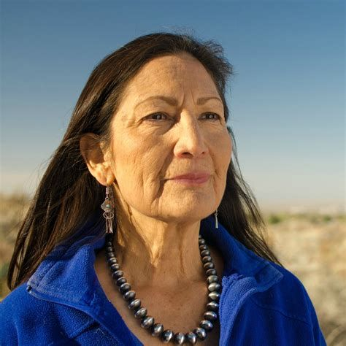
Secretary of the Interior Deb Haaland

Slide 10
Deb Haaland and the BIA-OJS
On April 1, 2021, Secretary of the Interior Deb Haaland announced the formation of a new Missing & Murdered Unit (MMU) within the Bureau of Indian Affairs Office of Justice Services (BIA-OJS) to provide leadership and direction for cross-departmental and interagency work involving missing and murdered American Indians and Alaska Natives.
The MMU will help put the full weight of the federal government into investigating these cases and marshal law enforcement resources across federal agencies and throughout Indian country.

Slide 11
Indigenous Political Resurgence
In recent years, sparked in part by the massive protests against the Dakota Access Pipeline, Indigenous political activism has been resurgent.
This has meant that legislation involving Indigenous populations has been more evident in New Mexico’s Statehouse recently.
Ex: the Indian Child Welfare Act (ICWA), the recent establishment of the MMIWR Taskforce

Slide 13
Recommended Resources
Coalition To Stop Violence Against Native Women https://www.csvanw.org/
Somebody’s Daughter (Film) https://www.somebodysdaughter.com/somebodys-daughter-the-film
https://www.nytimes.com/2019/12/25/us/native-women-girls-missing.html
New Mexico Missing and Murdered Indigenous Women and Relatives Task Force Report
https://www.iad.state.nm.us/wp-content/uploads/2020/12/NM_MMIWR_Report_FINAL_WEB_v120920.pdf

